Slide 1

CanberraUAV Workshop Flight Controllers
Feb 2017

Slide 2
Flight Controllers
Also known as Autopilot(s)
Take in information from sensors
Calculate the current state of the UAV
Compare this to where it’s supposed to be
Output that action to the engines and control surfaces

Slide 3
Flight Controllers
Can have different levels of automation
Stabilisation
Waypoint-based navigation
Full decision-making capability
May have failsafes for recovery from emergency situations

Slide 4
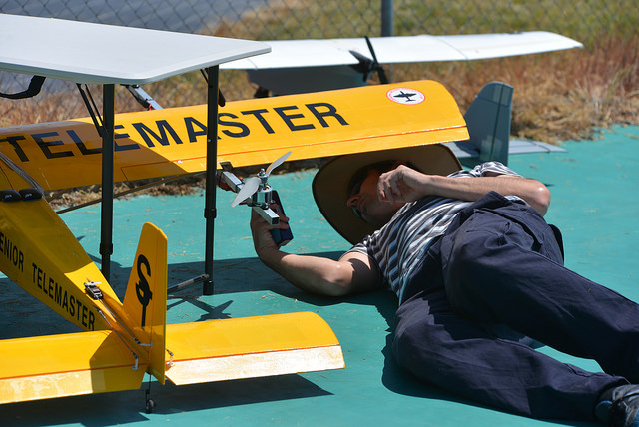
Popular Flight Controllers
Open-source
Ardupilot
PX4
Paparazzi
Cleanflight
KKMulticopter
MultiWii
Naze32

Slide 5
APM History - Ardupilot
Also known as
Arducopter/Arduplane/Ardurover
APM
Capable of controlling many different types of vehicles
Planes, Multicopters, Helicopters, Rovers, Boats, Submarines
Waypoint-based navigation
Advanced failsafe system
Highly configurable via (many!) parameters

Slide 6
APM History - Ardupilot
Started in 2009 by Jordi Munoz, Doug Weibel, and Jose Julio
Designed to run on an Arduino board
Jordi Munoz and Chris Anderson went on to found 3D Robotics
Open source (GPL V3) project

Slide 7
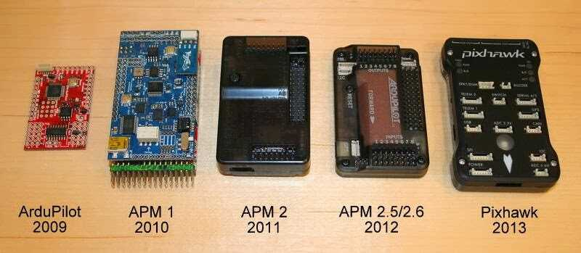
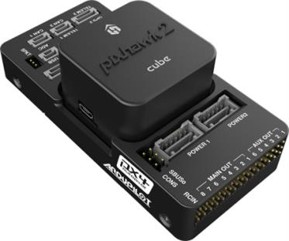
APM History - Hardware
Pixhawk 2(.1) (2016)
Arduino
ARM

Slide 8
APM Basics - Ardupilot Organisation
Was previously funded by 3D Robotics
3DR heavily used the Ardupilot software in their UAV’s
Also sold many DIY parts
Was part of the Dronecode foundation
In early 2016, moved to the ardupilot.org non profit organisation

Slide 9
Before we go any further…
All information if based on the current Arduplane release (3.5.2)
Some settings/parameters may be different for Arducopter/rover
Some settings/parameters may change in future releases of Arduplane

Slide 10
APM Basics - Maintainers
Andrew Tridgell
Vehicle: Plane, AntennaTracker
Board: APM1, APM2, Pixhawk, Pixhawk2, PixRacer
Randy Mackay
Vehicle: Copter, AntennaTracker
Robert Lefebvre
Vehicle: TradHeli
Grant Morphett:
Vehicle: Rover
Tom Pittenger
Vehicle: Plane
Paul Riseborough
Subsystem: AP_NavEKF2
Lucas De Marchi
Subsystem: Linux
Peter Barker
Subsystem: DataFlash
Subsystem: Tools
Michael du Breuil
Subsystem: uBlox GPS
Francisco Ferreira
Bug Master
Matthias Badaire
Subsystem: FRSky
Víctor Mayoral Vilches
Board: PXF, Erle-Brain 2, PXFmini
Mirko Denecke
Board: BBBmini
Georgii Staroselskii
Board: NavIO
Emile Castelnuovo
Board: VRBrain
Julien BERAUD
Board: Bebop & Bebop 2
Pritam Ghanghas
Board: Raspilot
Jonathan Challinger
Vehicle: 3DRobotics Solo ArduPilot maintainer
Gustavo José de Sousa
Subsystem: Build system
Craig Elder
Administration: ArduPilot Technical Community Manager

Slide 11
Ardupilot - HW vs SW
Ardupilot refers to the software
It can run on many different platforms
Pixhawk
BeagleBoneBlack
Raspberry Pi
X86
Many different ARM-based boards
(Arduino support has been dropped in recent versions)

Slide 12
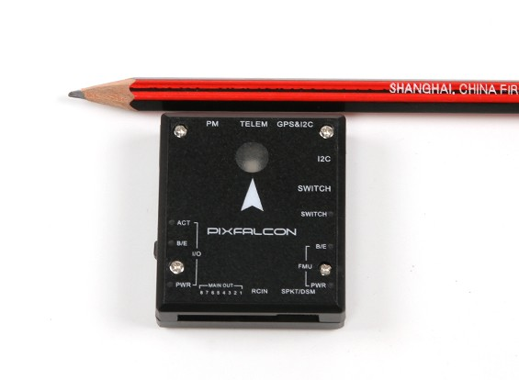
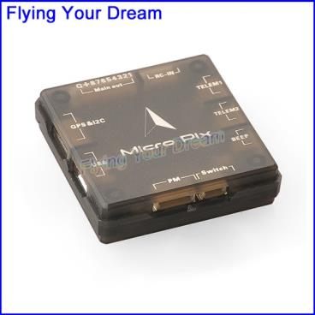
Ardupilot - HW vs SW
New hardware boards are being added regularly
Many variants of the Pixhawk platform in particular

Slide 13
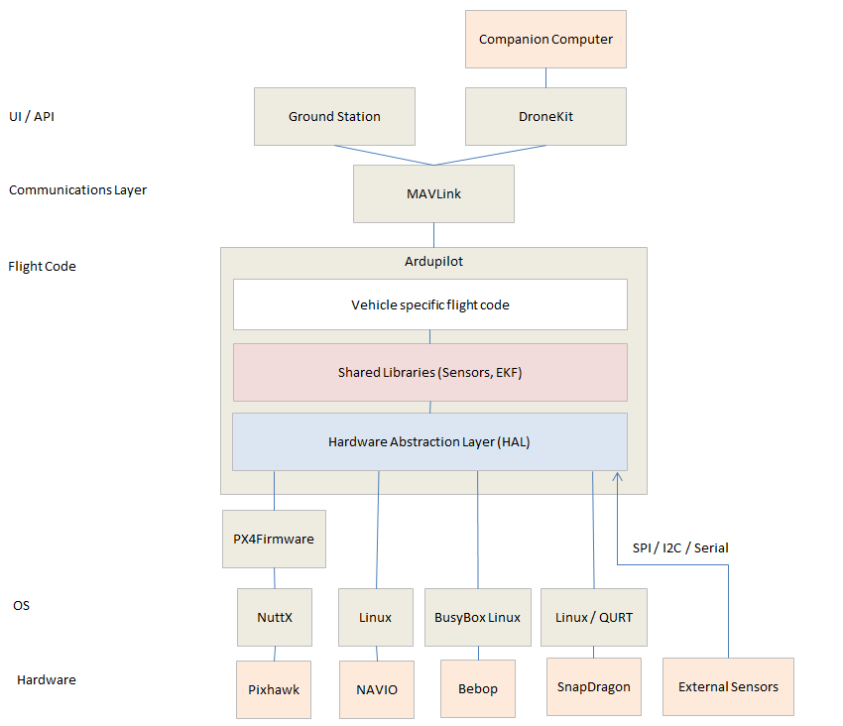
Ardupilot - Architecture

Slide 14
Ardupilot - Architecture
Core Libraries
AP_AHRS - attitude estimation using DCM or EKF
AP_Common - core includes required by all sketches and libraries
AP_Math - various math functions especially useful for vector manipulation
AC_PID - PID controller library
AP_InertialNav - inertial navigation library for blending accelerometer inputs with gps and baro data
AC_AttitudeControl -
AP_WPNav - waypoint navigation library
AP_Motors - multicopter and traditional helicopter motor mixing
RC_Channel - a library to more convert pwm input/output from APM_RC into internal units such as angles
AP_HAL, AP_HAL_AVR, AP_HAL_PX4 - libraries to implement the “Hardware abstraction layer” which presents an identical interface to the high level code so that it can more easily be ported to different boards.

Slide 15
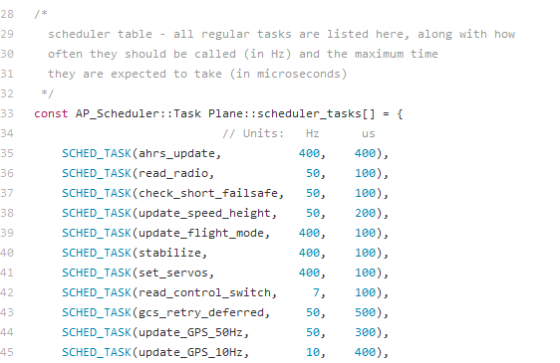
Ardupilot - Architecture
Multithreaded (where supported) for low-level IO work and sensor drivers
Uses the AP_Scheduler library in the main vehicle thread

Slide 16
Ardupilot - Architecture
2 Persistent Storage areas
StorageManager
Parameters
Waypoints
Geofence points
Rally points
DataFlash
System log
Are the *.bin files on the Pixhawk SD card

Slide 17
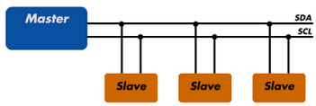

Ardupilot - Sensors
Sensors provide information about the current state of the UAV
Different communications buses are supported
I2C
SPI
UART
CAN

Slide 18
Ardupilot - Sensors
Gyro (I2C/SPI)
Accelerometer (SPI)
Magnetometer (I2C)
GPS (UART)
Power Sensor (I2C)
Barometer (I2C)
Pitot (I2C)
Laser Rangefinder (UART)
And more…
Support redundant sensors

Slide 19
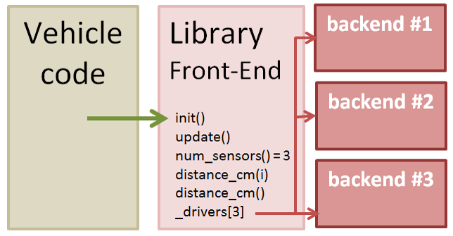
Ardupilot - Sensors
Sensors are auto-detected on startup
Hardware Abstraction Layer (HAL) separates the front and back end

Slide 20
Ardupilot - Preflight Checks
System performs a check before arming
Barometer
Inertial (Gyro/Accel)
Attitude solution (AHRS)
Compass
GPS
Battery
Airspeed
Logging
RC Control
Safety switch
Will not arm if a check fails
Checks can be disabled. Not recommended!

Slide 21
Ardupilot - Compiling
Building the code into a single binary file
Different compilers needed for each hardware target
G++ for Linux/Windows
GCC-ARM (non-eabi) 4.9.7 or 5.9.3 for Pixhawk

Slide 22
Ardupilot - Compiling
Ardupilot uses the “waf” make system
waf --board=navio2 --targets =bin/arduplane
--board is the hardware target (sitl, px4-v1, etc)
--target is the airframe type (coax heli hexa octa octa-quad single tri y6 )
waf --help to get documentation

Slide 23
Ardupilot - Compiling
Useful waf commands
waf list
Lists all vehicle types (and other test programs)
waf list-boards
Lists all board targets
waf clean
Delete all files created during build
Also useful to add a -jx, where x is the number of threads to use in build

Slide 24
Ardupilot - Uploading
To upload to a Pixhawk
waf --upload /bin/arduplane
Mostly for working with the Pixhawk. Most other platforms (such as a Raspberry Pi) are a simple copy and paste

Slide 25
Ardupilot - SITL
Software In The Loop
Runs Ardupilot attached to a flight simulator
Jsbsim for Plane
Custom simulators for copter, rover
Can be attached to other simulators (Gazebo, Crrcsim, X-plane, etc)
Very useful for testing!

Slide 26
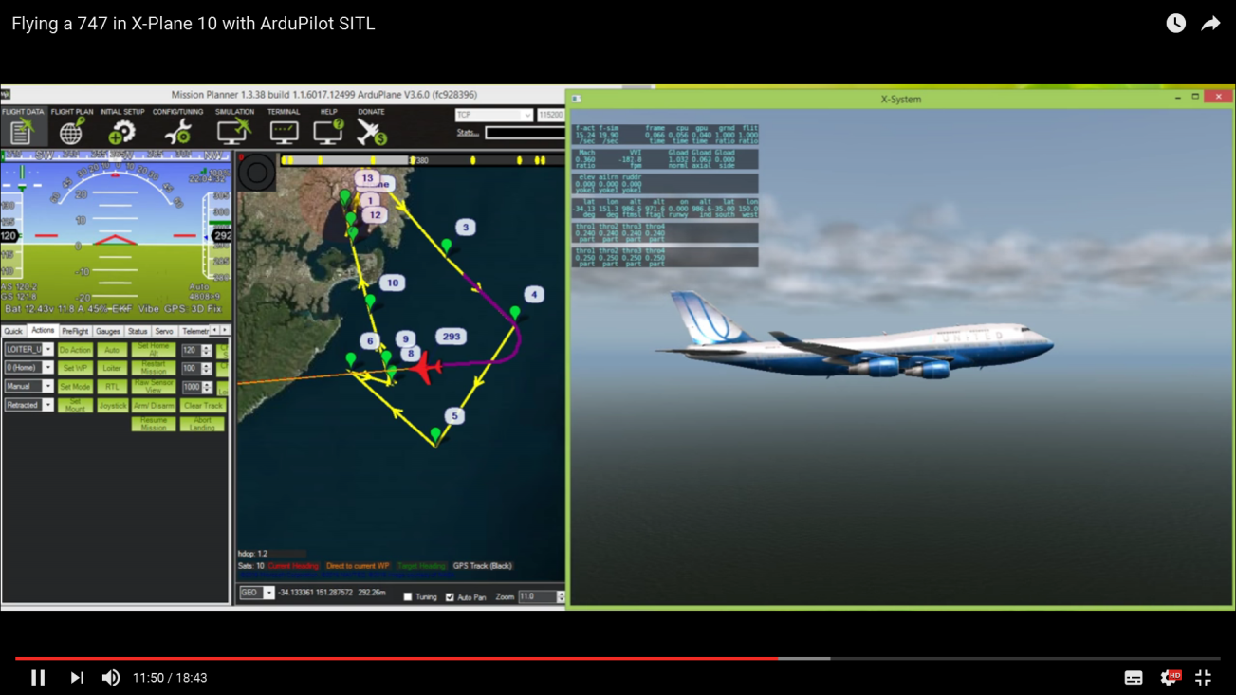
Ardupilot - SITL

Slide 27
Ardupilot - SITL
Ardupilot has a single script to build and run a SITL environment
cd ardupilot/ArduPlane
../Tools/autotest/sim_vehicle.py

Slide 28
Ardupilot - SITL
sim_vehicle options:
-w Wipe and reset EEPROM to defaults
-L <location> Start at a specific location (CMAC, Kingaroy, QMAC). Full list in ./Tools/autotest/locations.txt
--console Use the MAVProxy console
--map Enable to moving map
-f <frame> Use a specific frame (+, X, quad or octa for Arducopter)

Slide 29
Practical Session 1 (20min)
Configure WAF and build Arduplane
cd ./ardupilot
alias waf="$PWD/modules/waf/waf-light"
waf configure --board=sitl
waf --board=sitl --targets=bin/arduplane
Try building Arducopter
waf --board=sitl --targets=bin/arducopter-quad

Slide 30
Ardupilot - Mission
A mission is a set of waypoints that will be flown in auto mode
Missions are quite simple
Go here, do that
No conditional statements or branching
But can do loops
Some exceptions (we’ll see later)

Slide 31
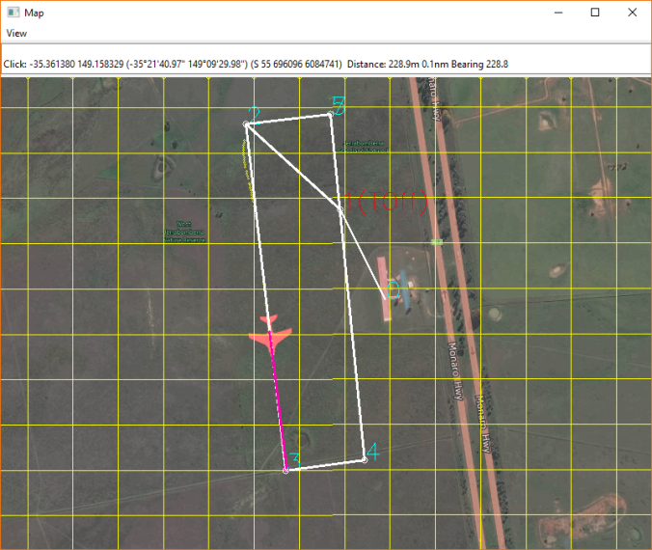
Ardupilot - Waypoints
Simple text file
Each line is one waypoint
Can be
Navigation commands
Do auxiliary function
Condition commands

Slide 32
Ardupilot - Waypoints
File starts with line QGC WPL 110
Next line is the home location
Each line thereafter is a series of 12 tab-separated values
Wp index number
Current wp
Coordinate frame
The waypoint type
Next 7 columns are the waypoint options
Last column is autocontinue

Slide 33
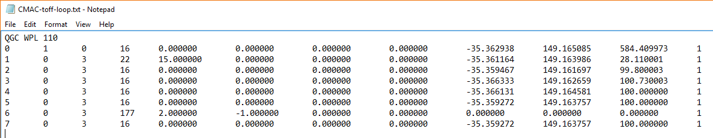
Ardupilot - Waypoints
Frame
0 = absolute altitude
3 = relative altitude
X,Y,Z coords
Waypoint Type
16=Navigate to WP
22=Autotakeoff
177=Do Loop

Slide 34
Ardupilot - Waypoints
Popular waypoints
MAV_CMD_NAV_WAYPOINT (Navigate to the specified position
MAV_CMD_NAV_LOITER_TIME (Loiter at the specified location for a set time)
MAV_CMD_NAV_RETURN_TO_LAUNCH (Return to the home location or the nearest Rally Point)
MAV_CMD_DO_JUMP (Jump to the specified command in the mission list)

Slide 35
Ardupilot - Waypoints
MAV_CMD_DO_SET_RELAY (Set a Relay pin’s voltage high (on) or low (off))
MAV_CMD_DO_SET_SERVO (Set a given servo pin output to a specific PWM value)
MAV_CMD_CONDITION_DISTANCE (Delay next DO_ command until less than x metres from next waypoint)
Plus many more…

Slide 36
Ardupilot - Flight Modes
Many flight modes that give different mixes of user and computer controlled output
MANUAL Complete manual control
FLY BY WIRE_A (FBWA) Will hold roll and pitch
AUTO Will run the mission stored in memory
Return To Launch (RTL) Will return straight to home point
LOITER Circle around current location
… plus more modes

Slide 37
Ardupilot - Failsafes
Failsafes are systems that take over control of the UAV if there is a perceived emergency
User configurable
Ensure you know which failsafes are active and:
Under what condition they will activate
Ardupilot’s resulting action(s)
How to regain control

Slide 38
Ardupilot - Failsafes
Short Failsafe
Default 1.5 sec
Choice of either Continue or circle
Long Failsafe
Default 5 sec
Choice of either Continue or RTL

Slide 39
Ardupilot - Failsafes
RC Failsafe
Activates at loss of signal from RC transmitter
Requires RC TX/RX to be set up first, so it can signal Ardupilot on loss of signal
Most recievers have a failsafe mode. Need to set this to output a low throttle value (<950 PWM)
GCS Failsafe
Activates at loss of heartbeat packets from GCS

Slide 40
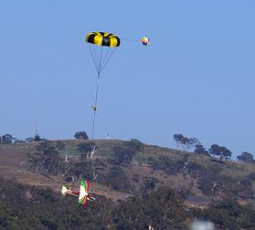
Ardupilot - Failsafes
Battery voltage Failsafe
Activates when battery reaches low voltage
Battery remaining Failsafe
Activates when remaining battery charge (mAh) is reached

Slide 41
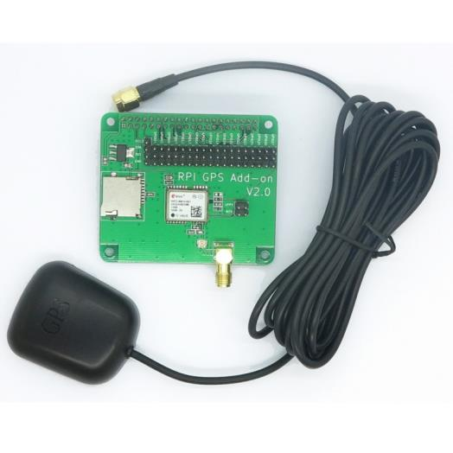
Ardupilot - Failsafes
GPS
There is not a GPS failsafe in Arduplane
Plane will warn the user and attempt to dead-reckon

Slide 42
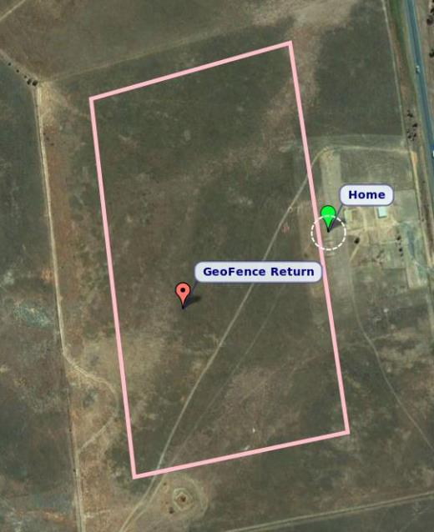
Ardupilot - Failsafes
Geofence
A set of points that define a closed polygon around the UAV
Can have altitude limits
Ardupilot Response can be:
Ignore
Report
Take over control and return
Disable for takeoff and landing!

Slide 43
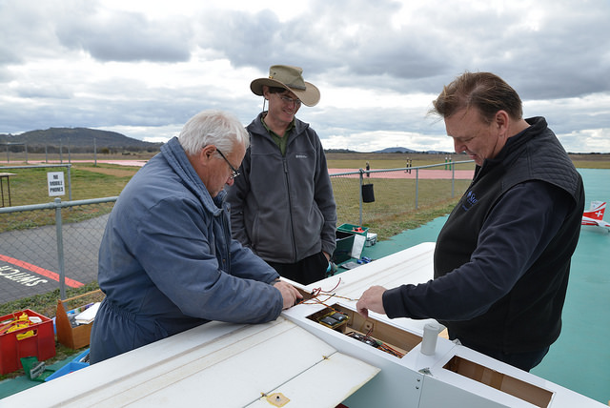
Ardupilot - Failsafes
There is an Advanced Failsafe System (AFS)
Designed to comply to the rules of the UAV Challenge

Slide 44
Practical Session 2 (20min)
Type this in Cygwin console
Run sim_vehicle for a plane at CMAC, with default parameters, console and map
cd ./ArduPlane
../Tools/autotest/sim_vehicle.py -w --console --map
Load a mission
wp load ../Tools/autotest/ArduPlane-Missions/CMAC-toff-loop.txt
Run the mission in AUTO mode
arm throttle
auto
Type this in MAVProxy console

Slide 45
Ardupilot - Tuning
Each airframe has different responses to movements in it’s flight control surfaces
Ardupilot needs to take account of these responses for precise control
3 Controllers that require tuning
PID (roll, pitch and yaw)
L1 (horizontal navigation)
TECS (height controller)
PID is the most important
L1 and TECS defaults will cover most circumstances

Slide 46
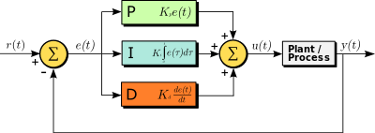
Ardupilot - Tuning
PID Controllers

Slide 47
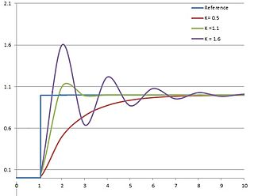
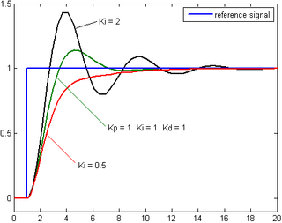
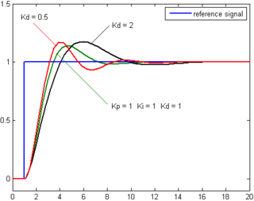
Ardupilot - Tuning
P
I
D

Slide 48
Ardupilot - Tuning
PID tuning can be done manually or via autotune
Manual: One person flies the UAV whilst the GCS operator monitors the roll/pitch response and changes the PID values
Autotune: As above, but Ardupilot automatically measures the roll/pitch reponse and changes the PID values.

Slide 49
Ardupilot - Tuning
Total Energy Control System (TECS)
Coordinates throttle and pitch angle demands to control the aircraft’s height and airspeed
Trading off demanded speed and demanded climb rate
Complex tuning method

Slide 50
Ardupilot - Tuning
L1 controller
Controls horizontal turns both for waypoints and loiter
Tuning the navigation controller usually involves adjusting one key parameter, called NAVL1_PERIOD
Small value = sharp turns
Large value = gentle turns

Slide 51
Ardupilot - EKF
Extended Kalman Filter
Algorithm to estimate vehicle position, velocity and angular orientation
Take in measurements from all sensors (except rangefinder and pitot)
“Fuses” the readings from the sensors together for an accurate solution
Can reject readings with large errors
Single sensor failure can be handled
Does require a powerful CPU (>Arduino)

Slide 52
Practical Session 3 (20min)
Start up Arduplane SITL
Load and run the same mission as last time
Vary the L1 controller in the MAVProxy console
param set NAVL1_PERIOD n
Where n is between 5 and 40 (default 20)
Watch the effect on the turns
Vary the roll and pitch PID controllers in the MAVProxy console
param set RLL2SRV_P n
param set PTCH2SRV_P n
Where n is between 0.1 and 4 (default 2.5)
Watch the effect on the turns

Slide 53
The End!
Ardupilot History
Ardupilot Architecture
Sensors
Libraries
Compiling and SITL
Controller tuning
Useful links
http://ardupilot.org/plane/index.html
http://ardupilot.org/dev/index.html
http://discuss.ardupilot.org/

